Slide 1
Analysis of Singapore’s Premium Product Shop Placement
IBM Data Science Capstone Project
Kar Wai Lim 5 Jan 2020

Slide 2
Executive Summary
1. More than 70% of Singapore residents purchase premium products in store rather than online.
2. Using condomium rental data in Singapore, I find out the areas where Singapore residents are paying more for housing rental.
3. I use Foursquare API to look for potential competitors in premium products.
4. Clustering algorithm is used to cluster 174,780 rental data into 100 groups based on location and rental per room.
5. Illustration using folium package allows us to determine the best location — where there are many rich residents but little competitors.

Slide 3
Introduction
More than 70% of Singapore residents are purchasing premium products from local store rather than online
Great opportunity for businesses to set up physical premium stores in Singapore
This report will use data science to analyse where can a business set up physical premium stores in Singapore
foursquare API to look for existing premium stores in Singapore
condominium rental data to determine potential areas
Of interest to premium stores retailer such as Hermes and Louis Vuitton.

Slide 4
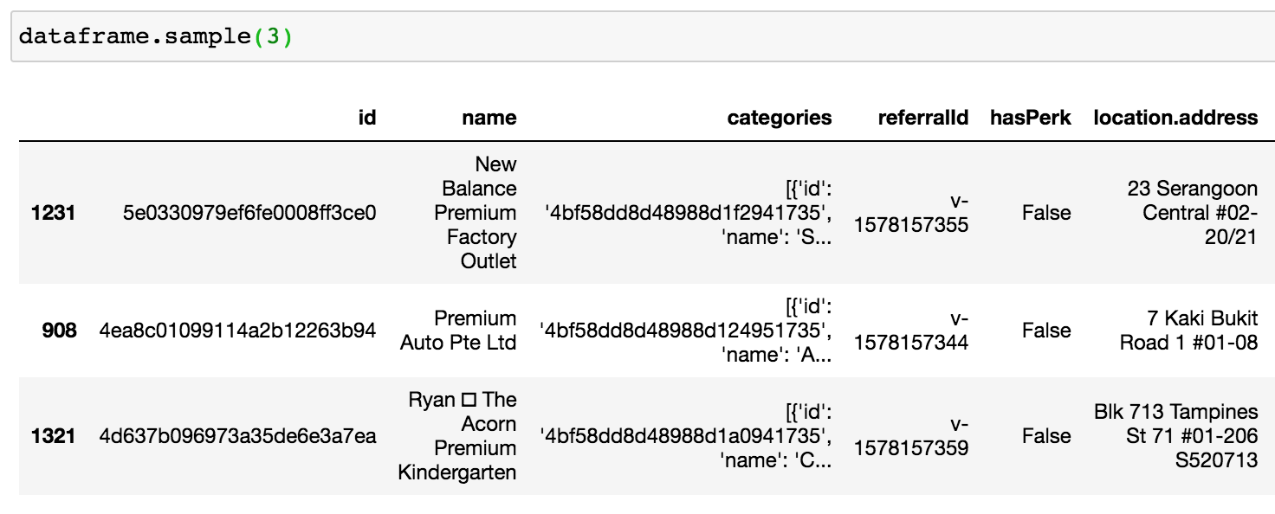
Data
Foursquare location data (use Foursquare API calls)
Find venues of existing physical premium stores

Slide 5
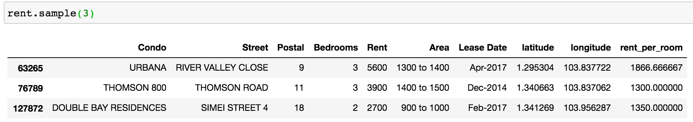
Data
Condominium rental data (from Urban Redevelopment Authority)
obtain the monthly rental associated with condominium units rented out
rental per number of bedrooms as strong indicator to the willingness to purchase premium products

Slide 6
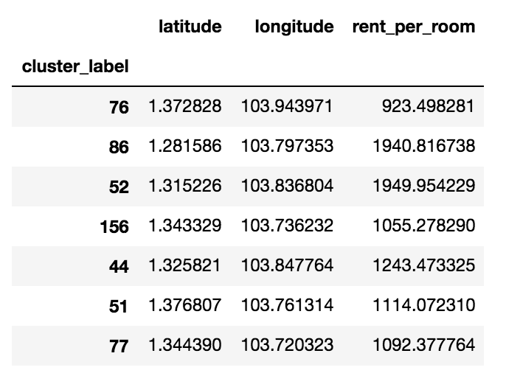
Methodology
K-means clustering
Large amount of rental data (174,780 data points) impractical to analysed manually
Use clustering (100 clusters) to group similar areas with similar rental per bedrooms
Summarise data based on cluster

Slide 7
Results and Discussions
Red circles are areas with higher willingness to spend on rental
Blue dots are existing premium stores

Slide 8
Recommendations
Recommend locations to set up physical premium stores:
Red circles that are far away from blue dots – e.g. Lakeside, Dairy Farm, Canberra

Slide 9
Conclusion
It is important for businesses to leverage data to make an inform decision.
We leveraged the data from Foursquare and URA to determine a suitable location for businesses to set up premium stores.
The best locations are found to be the areas where residents are paying high rental but with little existing premium stores.

